Slide 1
Basic network simulations using ns - 2
Presented by- Shanawaz Ali
Samarth Pratap Singh
Pradipta Kumar Sahoo
Vinay Kumar
Submitted to- Prof. Neeraj Tyagi
Dr. Mayukh Sarkar
Dr. Rajitha B

Slide 2
Introduction
Network simulation (NS) is one of the types of simulation, which is used to simulate the networks.
It provides simulation for routing and multicast protocols for both wired and wireless networks.
In ns2, C++ is used for detailed protocol implementation and Otcl is used for the setup.

Slide 3
Goal Of This Project
Understand how to write Tcl scripts to simulate simple network topologies and traffic patterns in NS-2.
Analyze the trace files and understand how to evaluate the performance of networking protocols and operations using :
XGraph tool for forming variable graphs and Netnam tool used for visualization .

Slide 4
Protocols used in the project
TCP(Transmission Control Protocol)-
A communications standard that enables application programs and computing devices to exchange messages over a network.
Connection Oriented
Slower than UDP
Reliable connection
E.g.: Sending mails, downloading files

Slide 5
UDP (User Datagram Protocol)
Used to establish low-latency and loss-tolerating connections between applications on the internet.
Unreliable
Not connection oriented
UDP speeds up transmissions by enabling the transfer of data before an agreement is provided by the receiving party.
E.g. - video calls, video games

Slide 6
Protocols used for creating traffic in a network
FTP(File Transfer Protocol)
It is a application layer protocol
Refers to a group of rules that govern how computers transfer files from one system to another over the internet.
E.g. Businesses use FTP to send files between computers, while websites use FTP for the uploading and downloading of files from their website's servers.

Slide 7
CBR(Constant Bit Rate)
it is used along with TCP and UDP to design the traffic source behavior of packets.
CBR provides low latency traffic with predictable delivery characteristics for telephony and also native voice applications.
It also offer support for timing sensitive traffic.
It utilizes the full capacity of channel also to provide high quality service.

Slide 8
Simple two node wired network
n0
n1
Step 1:
#Create a simulator object # (Create event scheduler) set ns [new Simulator]
Name of scheduler
Step 2:
#Open trace files set f [open out.tr w]
$ns trace-all $f

Slide 9
Simple two node wired network
n0
n1
#Create two nodes set n0 [$ns node] set n1 [$ns node]
Step 3:
Step 4:
#Create a duplex link between the nodes
$ns duplex-link $n0 $n1 1Mb 10ms DropTail

Slide 10
Simple two node wired network
#Create a simulator object
set ns [new Simulator]
#Open trace files
set f [open out.tr w] $ns trace-all $f
#Define a 'finish' procedure
proc finish {} {
global ns f $ns flush-trace close $f exit 0
}
#Create two nodes
set n0 [$ns node] set n1 [$ns node]
#Create a duplex link between the nodes $ns duplex-link $n0 $n1 1Mb 10ms DropTail
#Call the finish procedure after 5 seconds of simulation time
$ns at 5.0 "finish“
#Run the simulation $ns run
But we have no traffic!
11

Slide 11


Adding traffic to the link
n0 n1
udp
#Create a UDP agent and attach it to node n0 set udp0 [new Agent/UDP]
$ns attach-agent $n0 $udp0

Slide 12




Adding traffic to the link
n0
n1
udp
CBR: constant bit rate
cbr
# Create a CBR traffic source and attach it to udp0
set cbr0 [new Application/Traffic/CBR]
$cbr0 set packetSize_ 500
$cbr0 set interval_ 0.005
$cbr0 attach-agent $udp0

Slide 13





Adding traffic to the link
n0
n1
udp
null
cbr
#Create a Null agent (a traffic sink) and attach it to node n1
set null0 [new Agent/Null]
$ns attach-agent $n1 $null0

Slide 14




Adding traffic to the link
n0
n1
udp
null
cbr
#Connect the traffic source with the traffic sink
$ns connect $udp0 $null0 #Schedule events for the CBR agent
$ns at 0.5 "$cbr0 start"
$ns at 4.5 "$cbr0 stop”
$ns at 5.0 "finish"
$ns run

Slide 15
Record Simulation Trace
Packet tracing:
On all links:
$ns trace-all [open out.tr w]
On one specific link: $ns trace-queue $n0 $n1$tr
<Event> <time> <from> <to> <pkt> <size> -- <fid> <src> <dst> <seq> <attr>
+ | 1 0 2 cbr | 210 ------- 0 0.0 | 3.1 0 | 0
- | 1 0 2 cbr | 210 ------- 0 0.0 | 3.1 0 | 0
r | 1.00234 0 | 2 cbr 210 ------- | 0 0.0 | 3.1 0 0
Event “+”: enqueue, “-”: dequeue; “r”: received

Slide 16
Trace File Format
Address in “node.port” format
Event | Time | From Node | To Node | Pkt type | Pkt size | Flags | Fid | Src Address | Dest Address | Seq. Num | Pkt ID
cbt-tcp
User can set Flow ID in Otcl script for each source
Sequence no. can repeat Pkt ID is always unique
+ =enqueue
- =dequeue
r = recv (at the output of the link)
d = dropped

Slide 17


Case - I
8mbps
FTP
TCP
Sink1
7
1
16mbps
FTP
Sink2
TCP
2
4
5
6
3
8
TCP
Sink3
FTP
8mbps

Slide 18
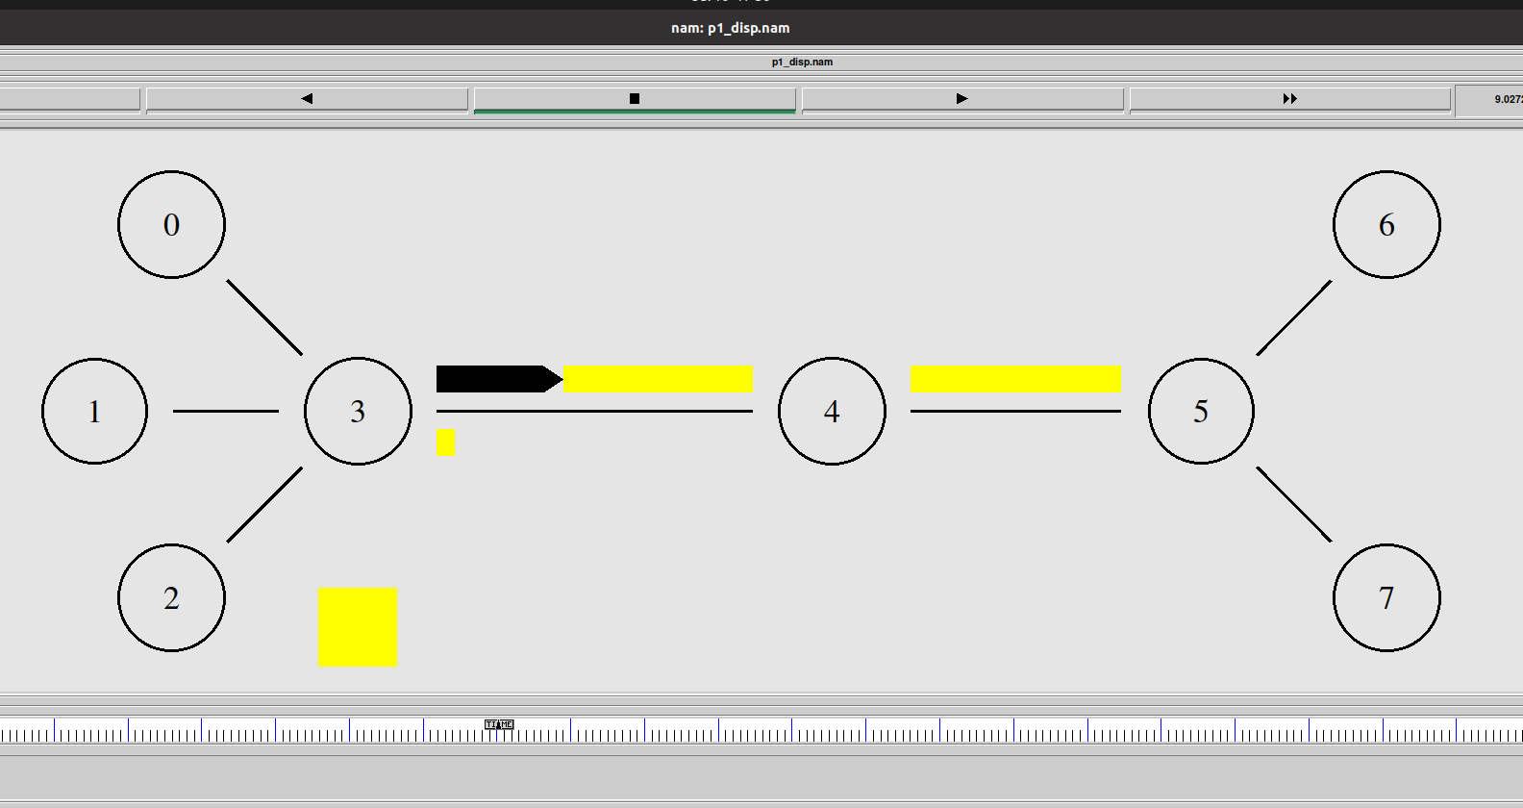
NAM Output

Slide 19
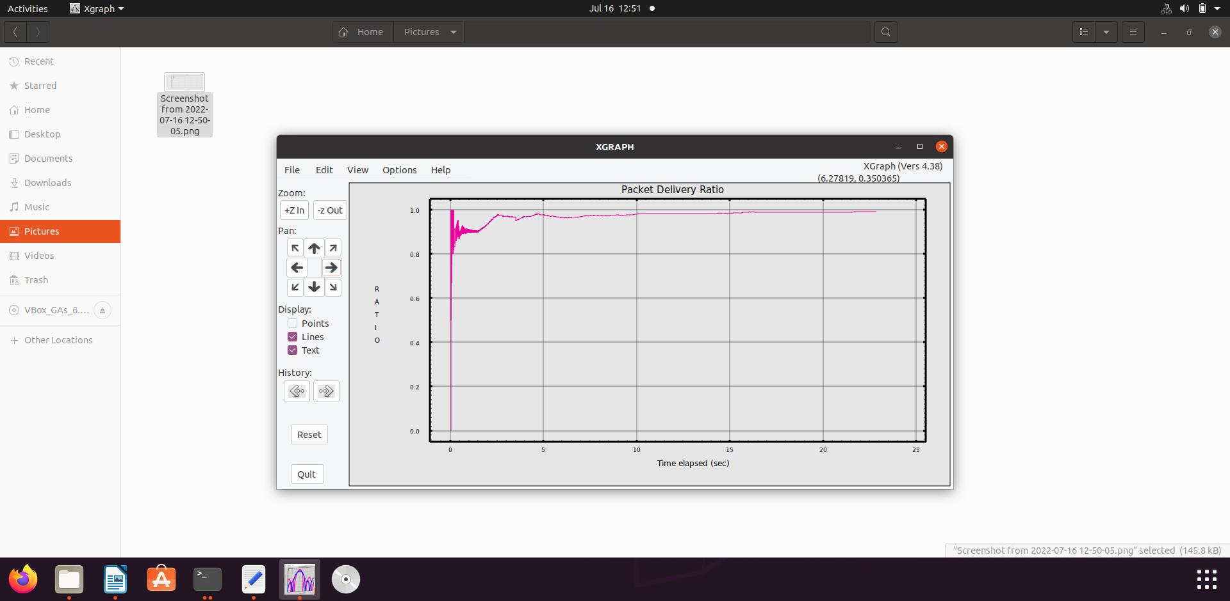
Packet Delivery Ratio

Slide 20
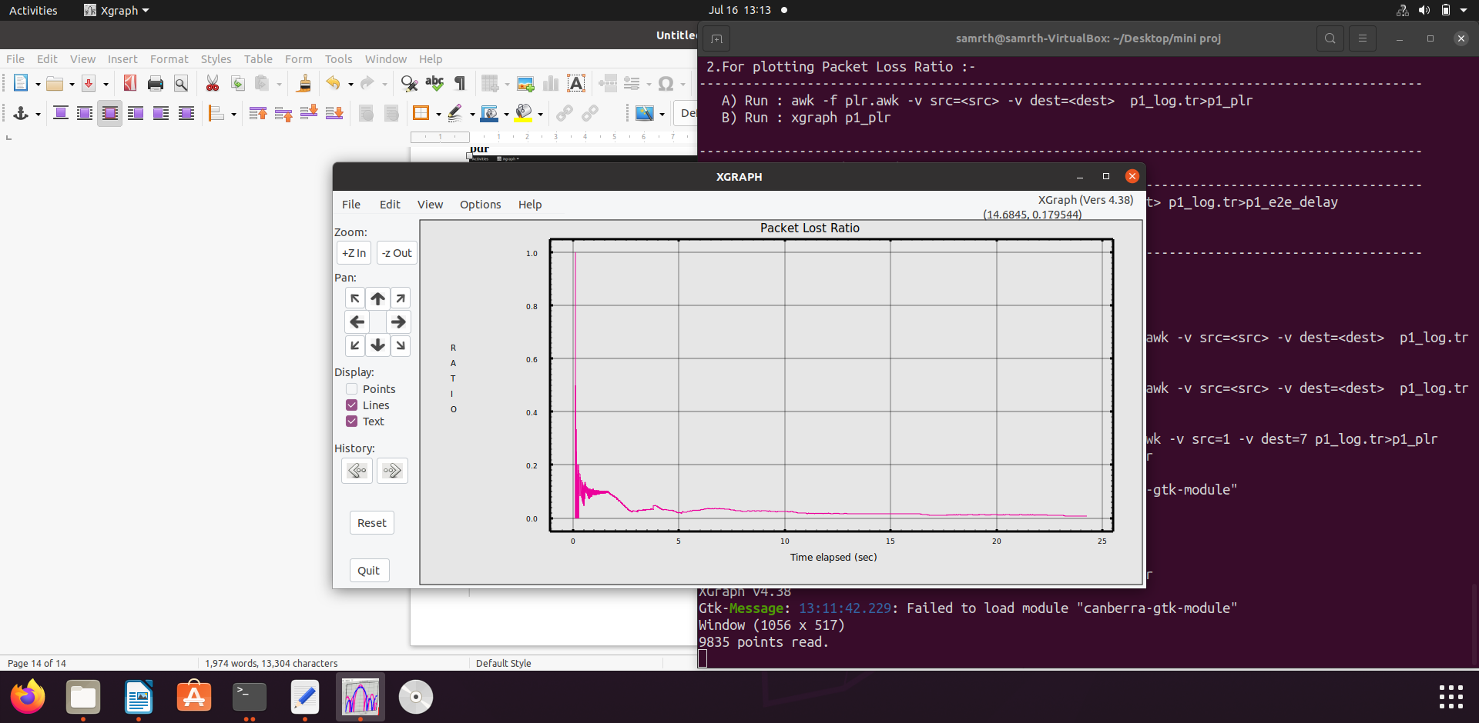
Packet Loss Ratio

Slide 21
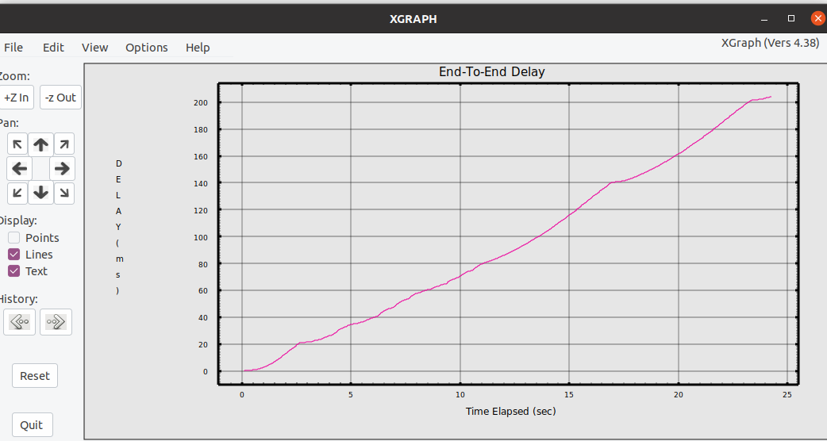
End-To-End Delay

Slide 22
Case - II
8mbps
FTP
TCP
Sink1
7
1
8mbps
10Mbps
FTP
Sink2
4Mbps
TCP
5Mbps
5Mbps
2
4Mbps
4
5
6
20Mbps
2Mbps
3
8
UDP
null
CBR
16mbps

Slide 23
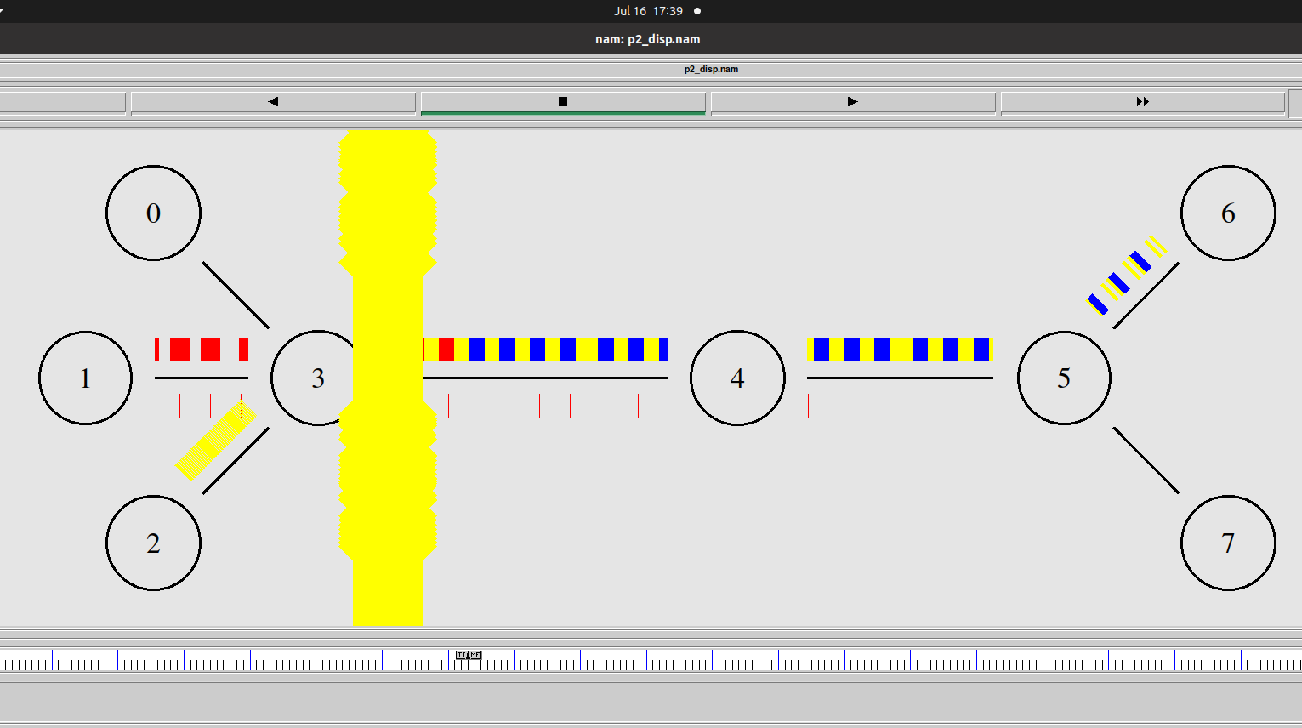
NAM Output

Slide 24
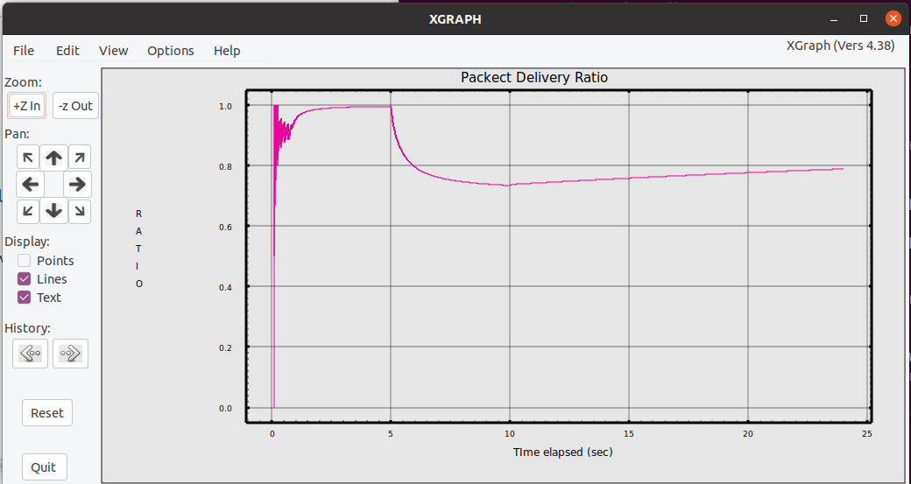
Packet Delivery Ratio

Slide 25
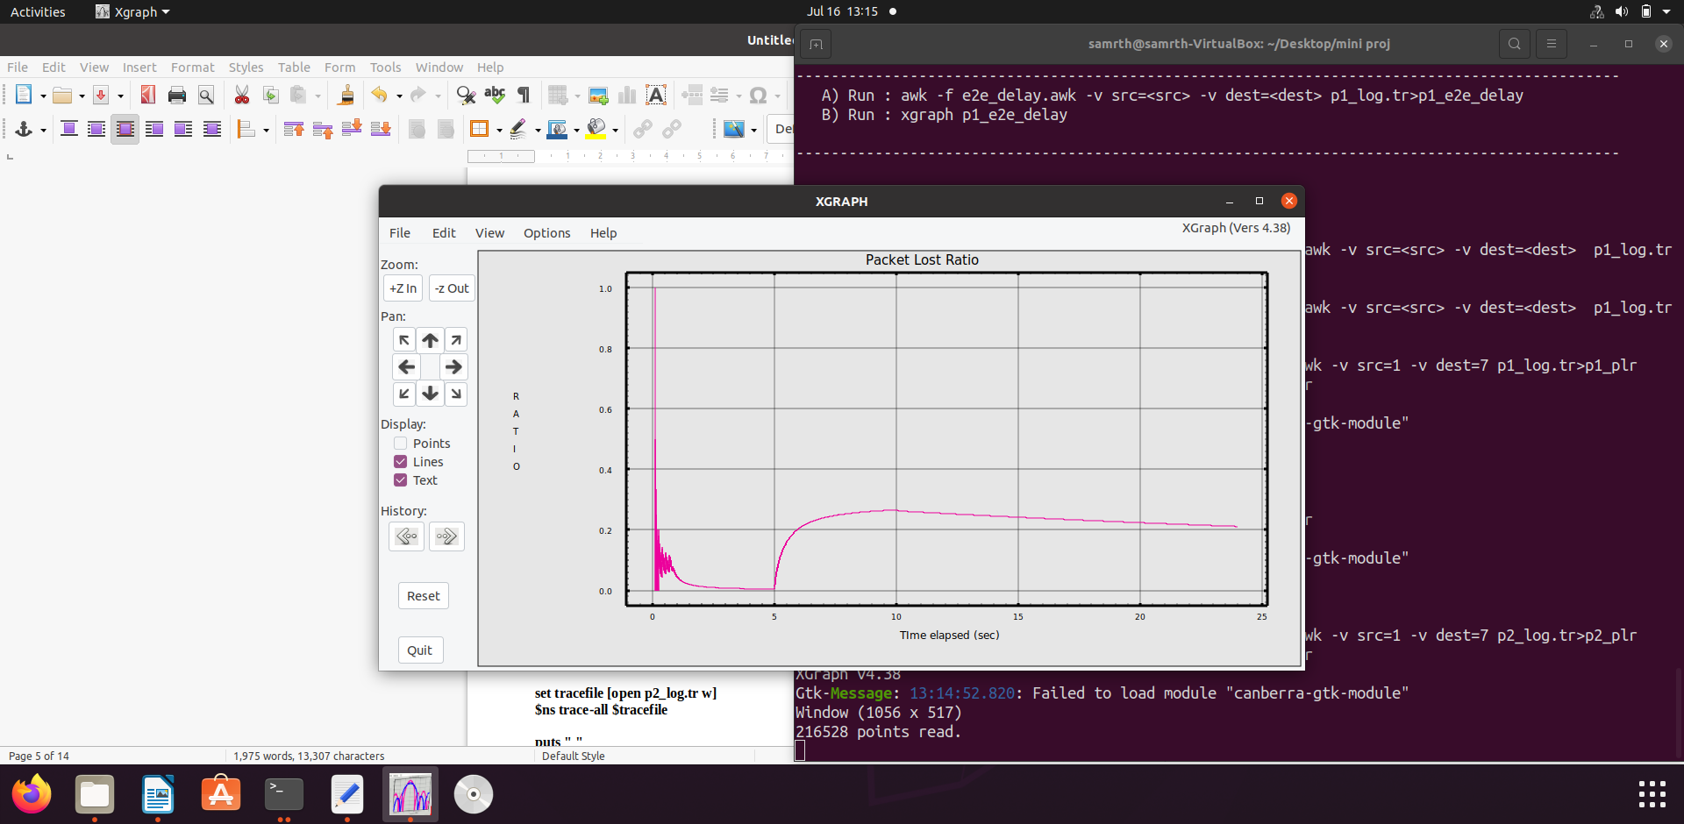
Packet Loss Ratio

Slide 26
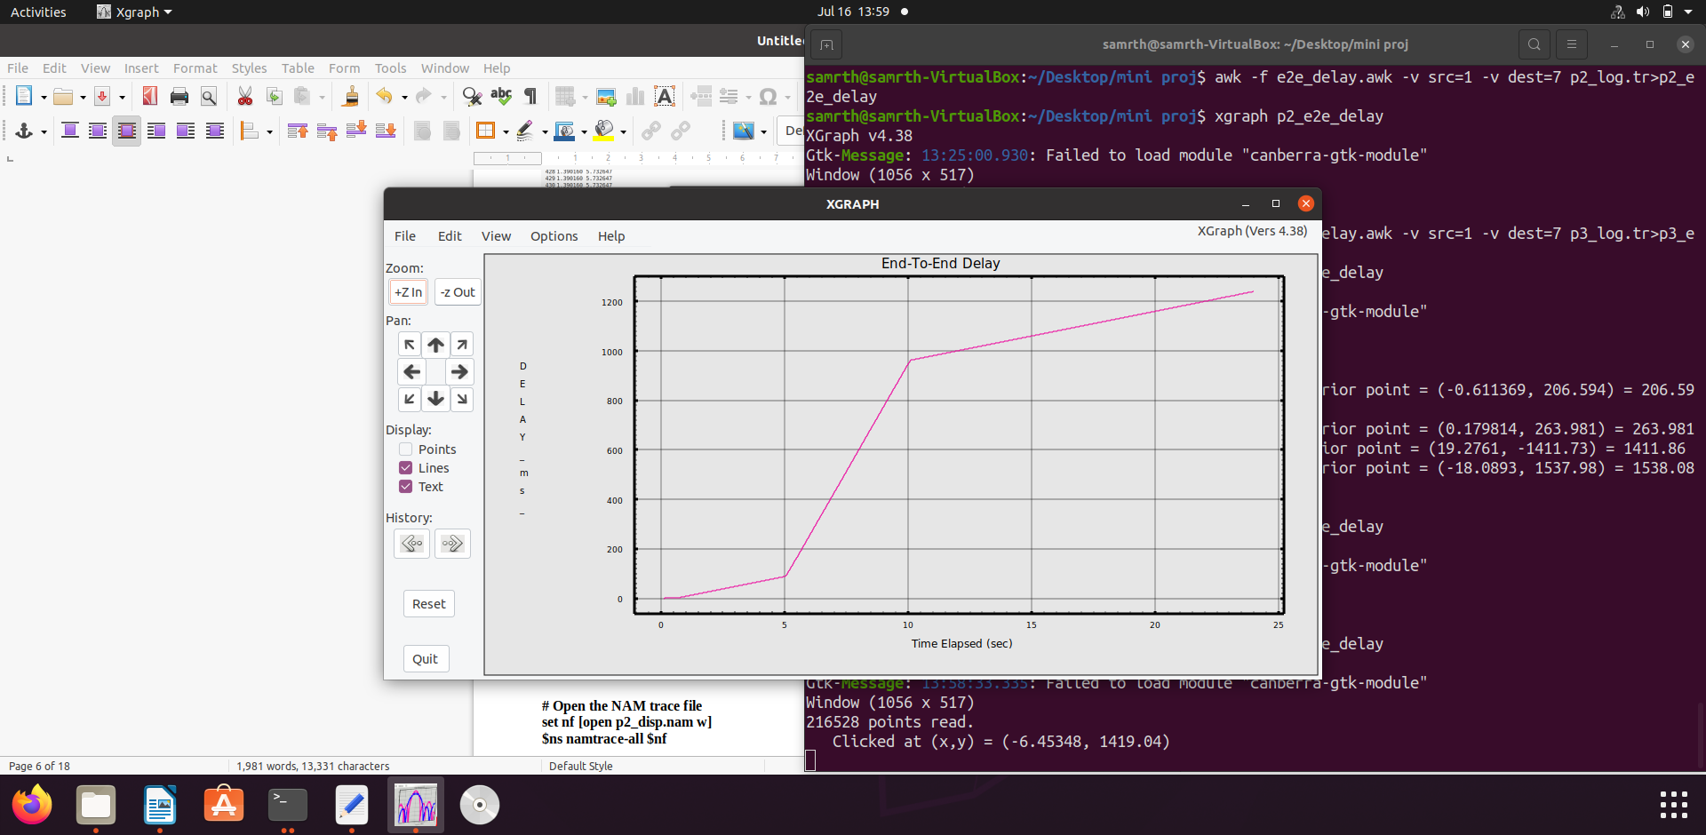
End-To-End Delay

Slide 27
Case - III
8mbps
FTP
TCP
Sink1
7
1
9mbps
20Mbps
CBR
null1
8Mbps
UDP
23Mbps
23Mbps
2
15Mbps
4
5
6
15Mbps
10Mbps
3
8
UDP
null2
CBR
8mbps

Slide 28
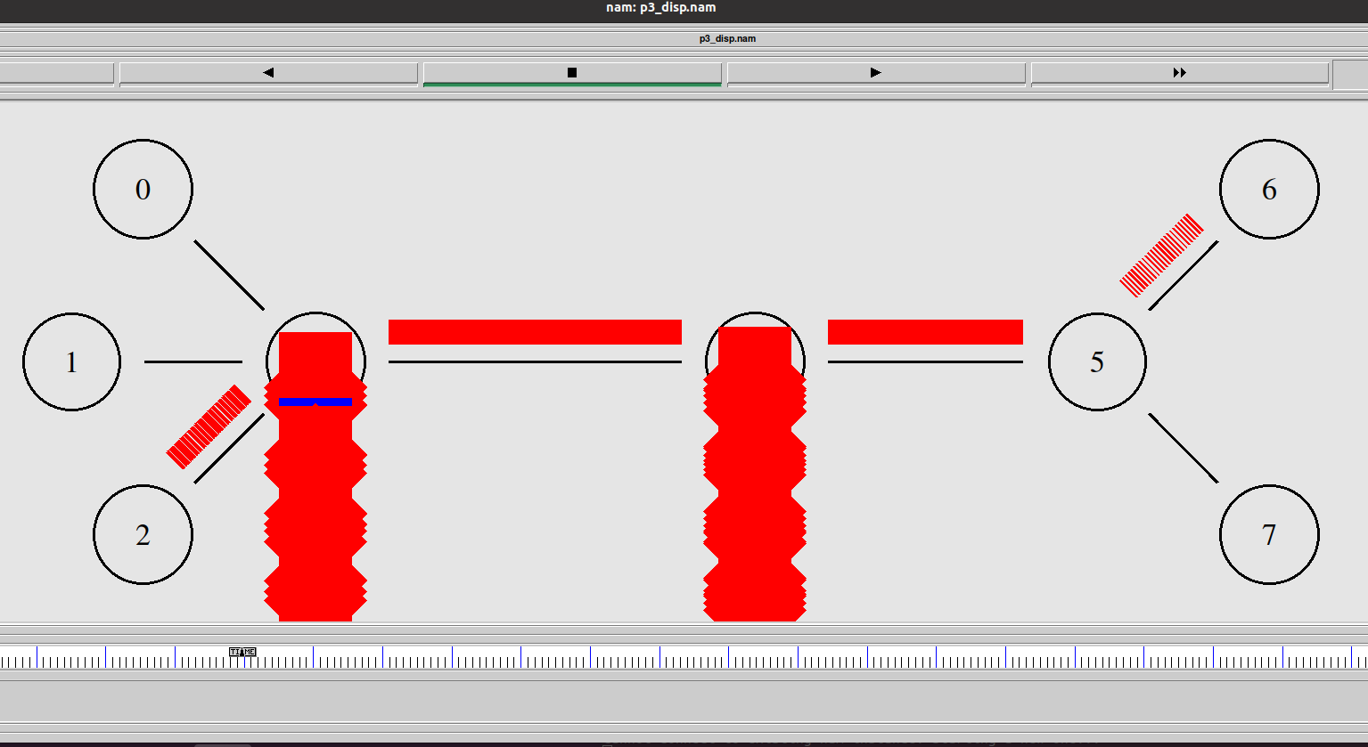
NAM Output

Slide 29
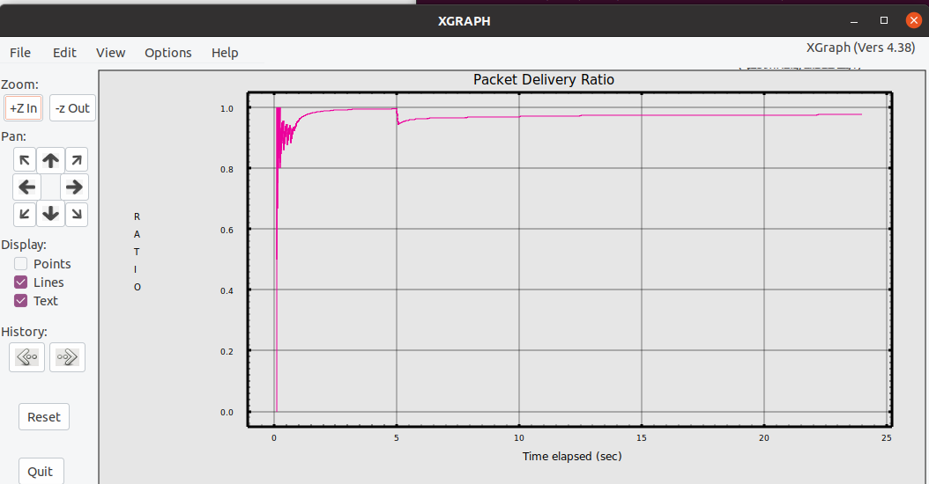
Packet Delivery Ratio

Slide 30
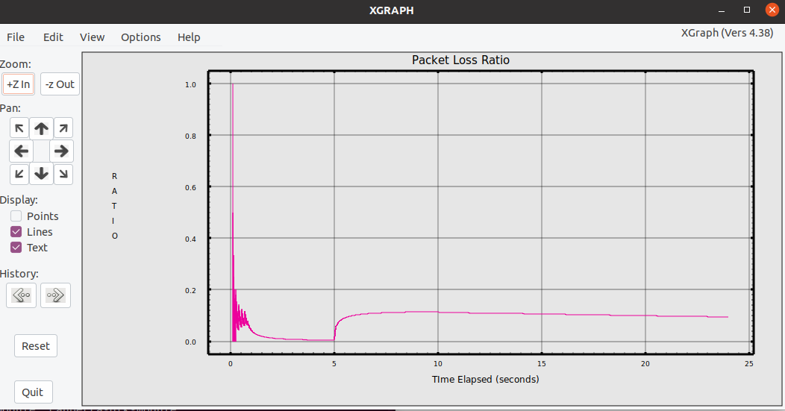
Packet Loss Ratio

Slide 31
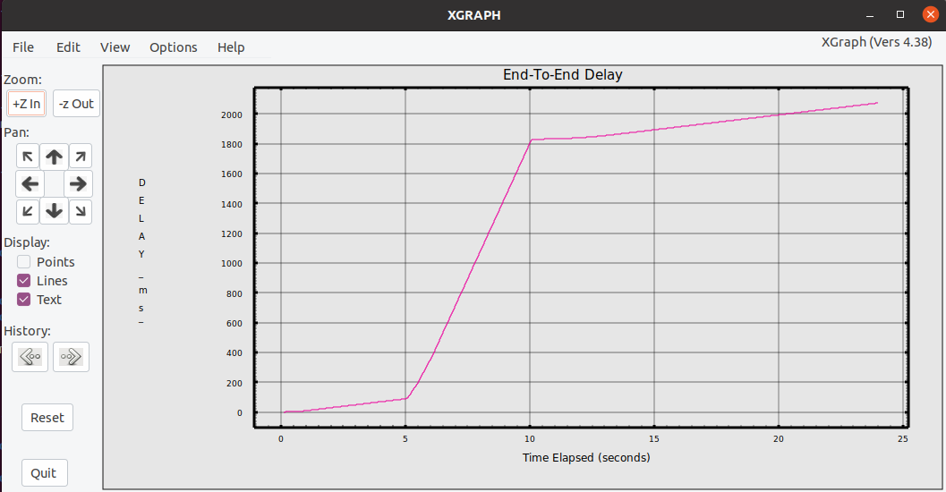
End-To-End Delay

Slide 32
Conclusion
We have understood how protocols simulation done using NS2. In the process we learn to write the TCL scripts. And, how nam visualization file and trace files generated through TCL scripts. We are also understand making different types of topologies and anlysing them using parameters like end-to-end delay, throughput, packet delivery ratios and packet loss ratios. We have seen how parameters act differently in different cases. There we also see how by changing the protocols and their respective traffic generators their come changes in graphs. We also come to know about various new terms such as bandwidth, throughput, droptail, transmission delay, propagation delay etc. And by forming graphs using AWK scripts, we also get a good insight of shell scripts.

Slide 33
Future Work
Will going to explore on wireless networks.
Protocols related to wireless networks are-
DSR, AODV, AOMDV, DSDV, OLSR
Also going to study about various other simulator like-
GNS3 , Qualnet, Opnet etc.

Slide 34
Thank you

